Slide 1
2026 Train the Trainer
Michigan Bureau of Elections
February 2026

Slide 2
Agenda
Notes:
Election Inspector Certification
Overview of conducting inspector training, and the purpose of the Train the Trainer course
Election Procedures
Reminders and Updates regarding the EPB programs used for Early Voting and Election Day, and training materials available
Developing Your Training Program
Best practices, including hands-on activities and scenario-based training
Key early voting and Election Day procedural points to train, as well as training resources available
Electronic Pollbook
Michigan Bureau of Elections
Train the Trainer 2026
2

Slide 3

Train the Trainer
Extras:
MCL 168.683 provides authority for training and certification of election inspectors.
Notes:
Train the Trainer is a certification course offered by the Bureau of Elections. All county clerks and any local clerks of cities or townships with more than 10,000 residents seeking to train and certify inspectors must take this course at least every two years.
Local clerks of jurisdictions below the threshold are not eligible under Michigan Election Law to certify election inspectors but may review training materials and provide supplemental sessions.
Michigan Bureau of Elections
Train the Trainer 2026
3

Slide 4
Providing Election Inspector Training
Notes:
MCL 168.683: Certified county clerks must offer election inspector certification training schools before each primary, general, and special election.
Michigan Bureau of Elections
Train the Trainer 2026
4

Slide 5
Election Inspector Eligibility
Extras:
16 or 17 year olds cannot serve as chair, but are still required to select political party affiliation.
The State of Michigan Election Inspector Application can be found on the michigan.gov/elections website
Notes:
Must
File an application with the city, township, or county clerk
Attend election inspector certification training at least every two years
Must Not
Have been convicted of a felony or election crime
Be a qualified and registered voter if 18 years of age or older (16- and 17-year-olds can be additional inspectors beyond required minimum)
Be a candidate on the ballot at the location, immediate family of a candidate, or extended family that lives with the candidate
Michigan Bureau of Elections
Train the Trainer 2026
5

Slide 6
Election Inspectors
Extras:
*For eligible jurisdictions that have processed over 500 registrations on Election Day
Resources:
Election Officials Manual Ch. 14
Notes:
Election inspectors must be appointed by the local election commission at least 21 days before each election, and work in each of the following settings:
Election Day polling places
Early voting sites
Absent voter counting boards
Receiving boards
Election Day vote centers*
Michigan Bureau of Elections
Train the Trainer 2026
6

Slide 7
Election Procedures
Key election inspector training points
Michigan Bureau of Elections
Train the Trainer 2026

Slide 8
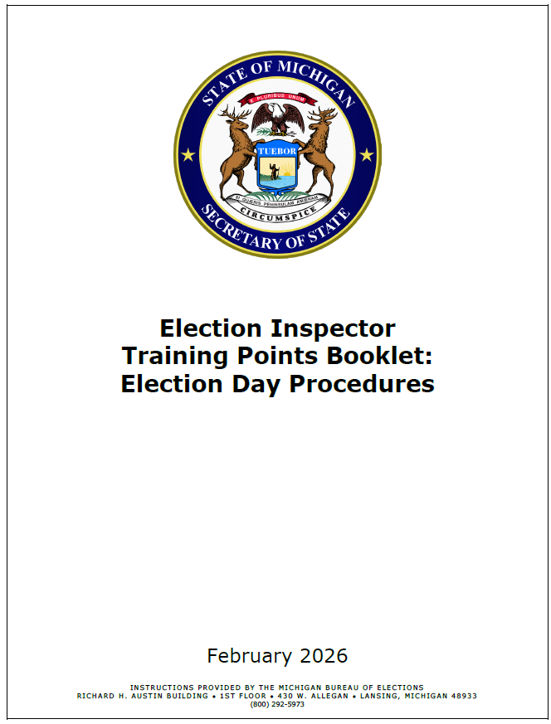
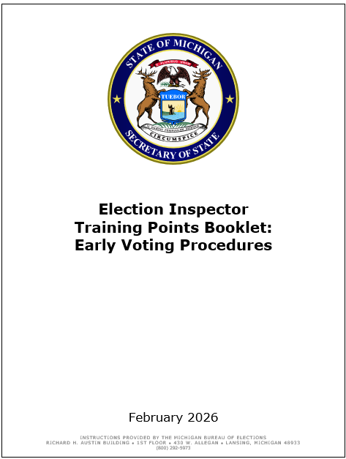
Key Training Resources
Resources:
2026 Training Points Booklet
Notes:
Coming Soon!
Michigan Bureau of Elections
Train the Trainer 2026
8

Slide 9
Opening the Polls – Election Day
Resources:
Opening the Polls Election Day Management Video
Election Inspector Procedure Manual
2026 Training Points Booklet
Notes:
Opening the polls procedure overview:
  Swear in all election inspectors
  Sign oaths
  Complete Election Inspectors’ Preparation Certificate
  Prepare tabulator
  Prepare e-pollbook (EPB)
  Prepare voter assist terminal (VAT)
  All postings must be hung and visible
  Display an American flag inside or outside
  Clear and barrier-free layout
  Announce 7 a.m. opening
Michigan Bureau of Elections
Train the Trainer 2026
9

Slide 10

Opening the Polls – Election Day Video
Michigan Bureau of Elections
Train the Trainer 2026
10

Slide 11
Opening the Polls – Election Equipment
Notes:
Each of the following devices must be set up by inspectors before the polls open:
Electronic pollbook (EPB)
Voter assist terminal (VAT)
Tabulator
Ballot On Demand (BOD) printer, if used during early voting
Michigan Bureau of Elections
Train the Trainer 2026
11

Slide 12
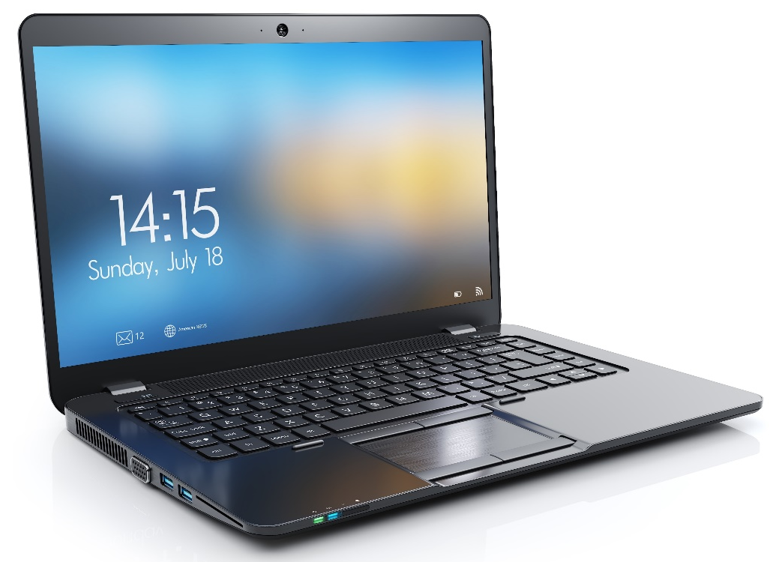
Opening the Polls – Election Day EPB
Extras:
Mag stripe readers must be replaced with bar code scanners for scanning licenses in voter lookup.
The laptop should remain plugged in throughout Election Day.
The flash drive should remain connected to the laptop through Election Day.
Resources:
Election Day EPB Inspector Manual
Election Day EPB Training Videos
Election Day EPB Training Database & Scenarios
Notes:
Preparing the electronic pollbook for use on Election Day:
  Once the laptop has powered up, insert and log into the BitLocker-encrypted flash drive.
  Open the EPB program on the desktop and log into the program.
  Perform first backup to establish the correct path, ensuring EPB data properly saves on the flash drive throughout Election Day.
  Add any additional users, as necessary.
  Ensure bar code scanner for voter lookup is plugged into the laptop and operational.
Michigan Bureau of Elections
Train the Trainer 2026
12

Slide 13
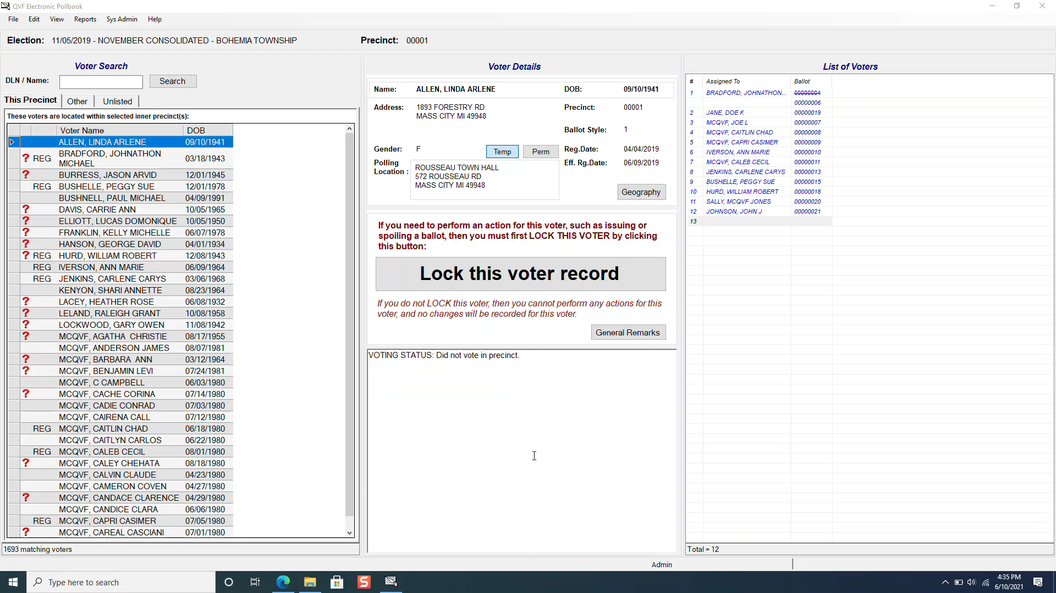
Opening the Polls – Election Day EPB Video
Michigan Bureau of Elections
Train the Trainer 2026
13

Slide 14
Opening the Polls – Tabulator
Extras:
Must be completed before 7am.
Challengers may be present and observe this process.
Resources:
Election Inspectors' Procedure Manual
Vendor Specific Preparation Manuals/Videos
Notes:
Preparing the tabulator on election morning:
  Refer to specific vendor instructions to start tabulator.
  Inspect the tabulator serial number and memory seal; confirm numbers match those recorded on Clerk's Preparation Certificate on front cover of poll book.
  Inspect inside the tabulator to ensure it is empty (including auxiliary bin).
  Print zero tape.
  Two election inspectors compare zero tape to sample ballot(s) to ensure all races are included on the tape, the correct ballots were delivered to the precinct and all totals equal zero.
  Verify the date and time are correct on the zero tape.
  Inspectors present sign the zero tape.
  Zero tape remains with the tabulator (do not tear off).
Michigan Bureau of Elections
Train the Trainer 2026
14

Slide 15
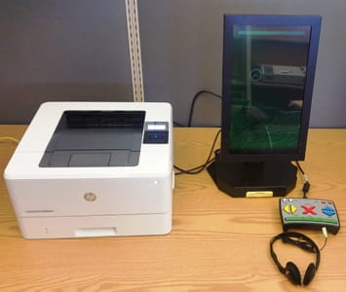
Opening the Polls - VAT
Extras:
Refer to vendor specific guidance for equipment setup
Resources:
Voter Assist Terminal (VAT) Instructions, Vendor Specific Preparation Guides, Vendor Specific Operations Guides
Notes:
Starting the voter assist terminal on election morning and each early voting day start:
Use the vendor specific instructions to start the VAT.
Inspect the VAT memory seal and compare to the VAT seal number recorded in the pollbook.
Print a blank test ballot using the VAT to ensure the VAT and the printer are functioning correctly.
Label the blank test ballot “ELECTION DAY TEST BALLOT” and insert the ballot into the local clerk envelope (this ballot will not be tabulated).
Michigan Bureau of Elections
Train the Trainer 2026
15

Slide 16
Opening the Polls – Early Voting (Day 1)
Resources:
Election Inspectors' Procedure Manual
Notes:
Preparing the tabulator on the first day of early voting:
  Refer to specific vendor instructions to start tabulator.
  Inspect the tabulator serial number and memory seal to confirm match against serial and seal numbers recorded on Clerk’s Preparation Certificate.
  Inspect inside the tabulator to ensure it is empty (including auxiliary bin).
  Print zero tape.
  Two workers compare zero tape to sample ballot/s to ensure all races are included on the tape, the correct ballots were delivered to the precinct and all totals equal zero.
  Verify date and time are correct on the zero tape.
  Day 1 Inspectors present sign the zero tape.
  Zero tape removed from tabulator and secured in physical pollbook.
Michigan Bureau of Elections
Train the Trainer 2026
16

Slide 17
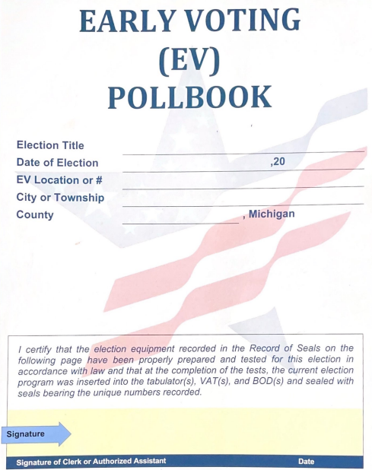
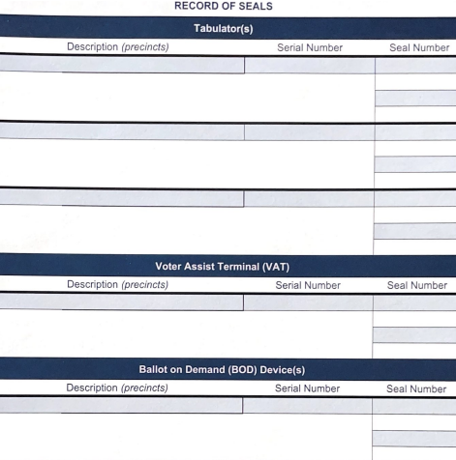
Opening the Polls – Early Voting (Day 1)
Extras:
It is important that tabulator serial numbers and memory seals are checked to verify the integrity of the of the equipment each day of early voting.
Notes:
Michigan Bureau of Elections
Train the Trainer 2026
17

Slide 18
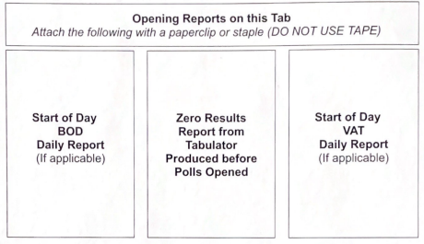
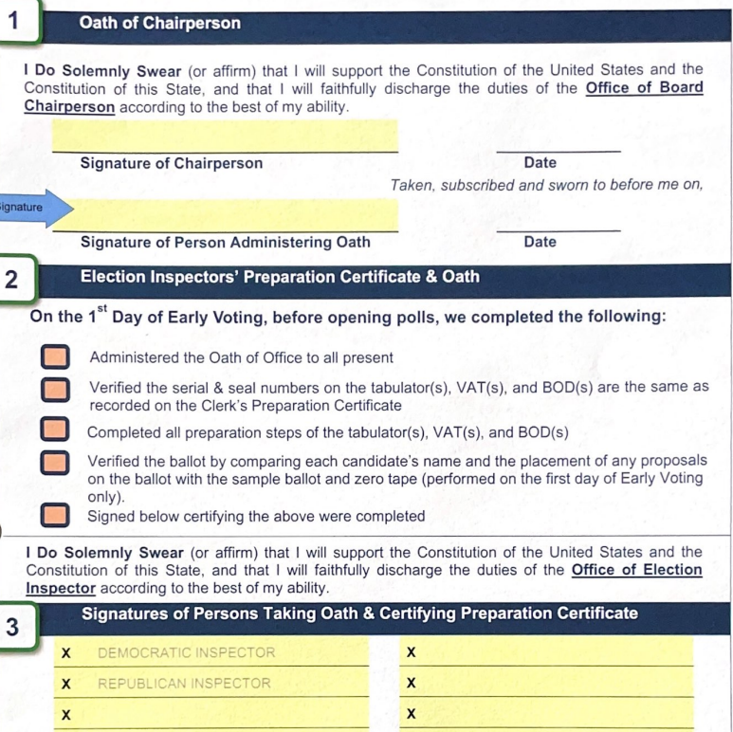
Opening the Polls – Early Voting (Day 1)
Extras:
Unlike Election Day Tabulator Zero Tape is detached from tabulator and secured in the pollbook.
Now required to include VAT and BOD reports.
Notes:
Michigan Bureau of Elections
Train the Trainer 2026
18

Slide 19
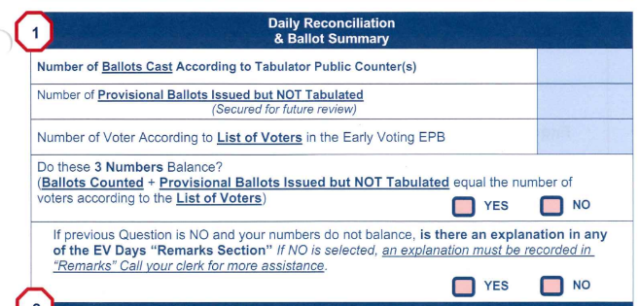
Opening the Polls – Early Voting (Day 2-9)
Extras:
Challengers may be present and observe this process.
Important to verify the number of voters in the Early Voting EPB at the opening each day matches the number of ballots tabulated, to attest that the chain of custody has not been broken from day to day of early voting.
Resources:
Election Inspectors' Procedure Manual
Vendor-Specific Tabulator Instructions
Notes:
Preparing the tabulator on each early voting start of day:
  Refer to specific vendor instructions to start tabulator.
  Inspect the tabulator serial number and memory seal number to confirm numbers match serial and seal numbers recorded on the Clerk’s Preparation Certificate in the physical pollbook.
  Inspect inside the tabulator to ensure it is empty (including auxiliary bin).
  Record the number of ballots cast according to tabulator public counter.
  Record number of voters according to Early Voting EPB.
  Print status tape.
  Verify public counter on tabulator is equal to the number on previous day’s reconciliation summary, and previous day’s status/interrupt report.
  Inspectors present at opening sign status tape, and secure in pollbook.
Michigan Bureau of Elections
Train the Trainer 2026
19

Slide 20
Processing Voters (Overview)
Resources:
Election Inspectors' Procedure Manual
Election Day Processing Voters Video
(In development)
Notes:
1. Voter enters the polling place and completes an Application to Vote.
2. Check voter ID/signed affidavit and locate voter in e-pollbook.
3. Check address, verify correct ballot and process voter in e-pollbook.
4. Initial Application to Vote.
5. Election inspector assigns ballot in EPB, enters ballot and voter number on Application to Vote.
Michigan Bureau of Elections
Train the Trainer 2026
20

Slide 21
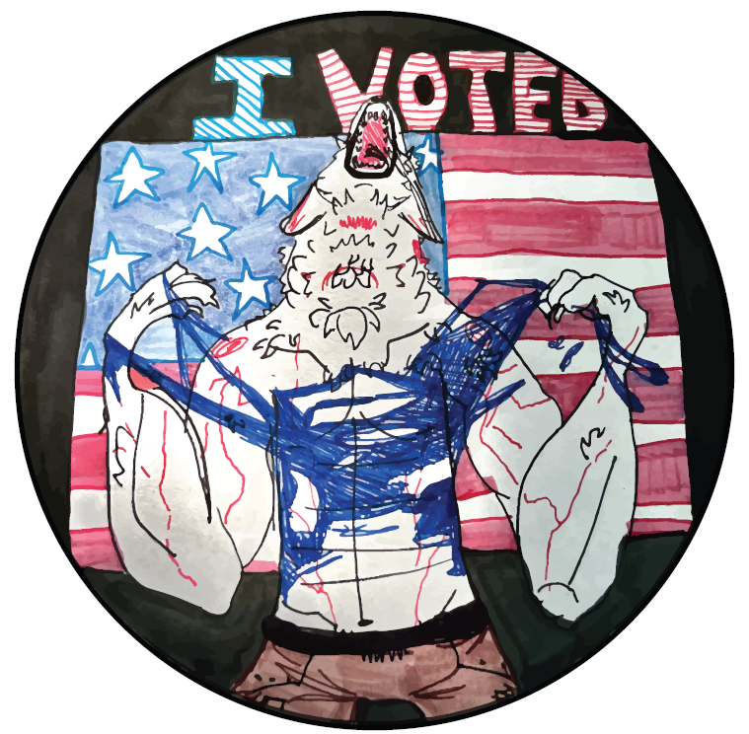
Processing Voters (Overview)
Resources:
Election Inspectors' Procedure Manual
Notes:
7. Voter votes ballot.
8. Election inspector verifies ballot number, removes stub and collects Application to Vote.
9. Voter inserts ballot into tabulator, and waits for confirmation.
10. Voter returns secrecy sleeve and gets “I Voted” sticker!
6. Give the voter their ballot when booth is available and give ballot marking instructions.
Michigan Bureau of Elections
Train the Trainer 2026
21

Slide 22
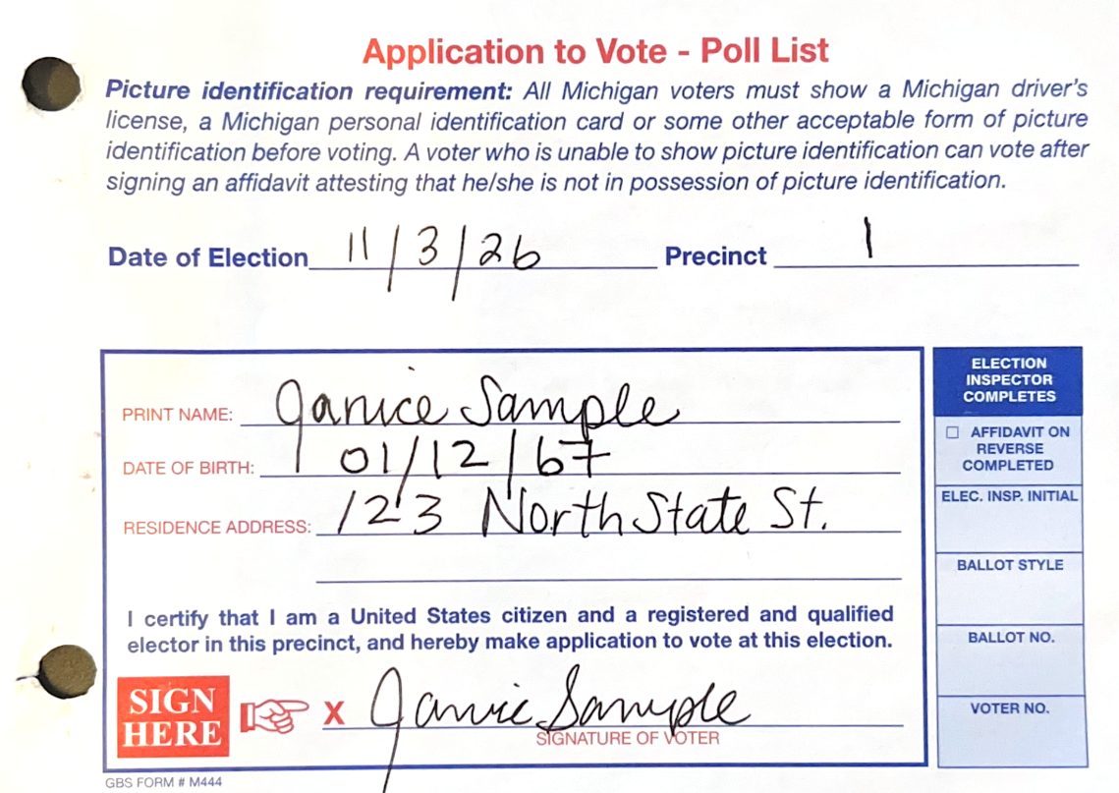

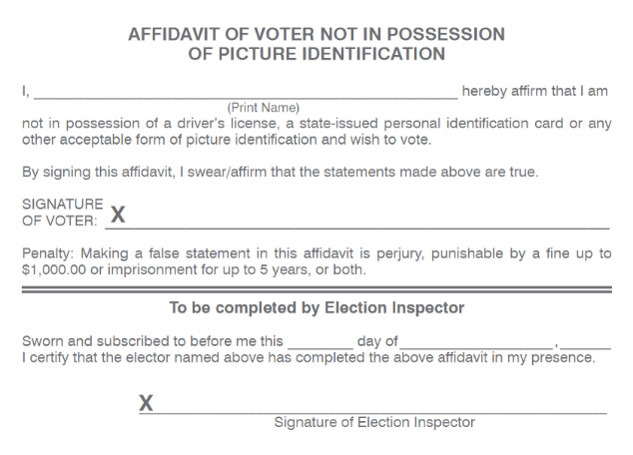
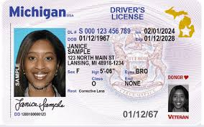
Processing Voters – Photo ID Requirement
Extras:
MCL 168.523 – Photo ID requirement and Applications to Vote.
Physical applications to vote serve as secondary list of voters.
Address on photo ID is not required to match address on voter record
Resources:
Voter Information Poster
Election Inspector Training Points Booklet
Notes:
Acceptable photo ID: driver’s license; federal, state, or local government-issued ID; U.S. Passport; military ID; educational institution ID; or tribal ID.
Voter not in possession of photo ID counted in Election Day EPB:
Not tied to individual voters
Election inspectors should utilize the “Affidavit of Voter Without Photo ID” ticker located above the Voter Details box of the EPB.
Michigan Bureau of Elections
Train the Trainer 2026
22

Slide 23
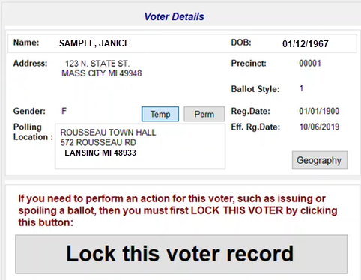
Processing Voters – EPB
Notes:
To determine eligibility, the voter’s address on the Application to Vote should then be verified with the address in the voter’s record in the electronic pollbook.
Michigan Bureau of Elections
Train the Trainer 2026
23

Slide 24




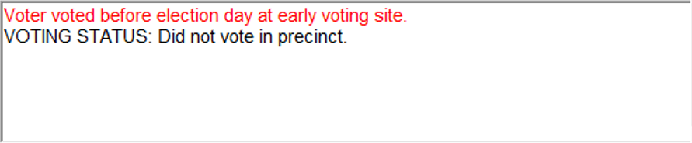


Processing Voters Election Day– EPB Status Flags
Extras:
Status flags in the EPB may require a voter to take additional steps before being issued a ballot
Resources:
Election Inspectors' Procedure Manual, Processing Voters Video, Appendices 1 & 2
Absent Voters in the Polls Guide
Notes:
Voters with statuses to address before issuing a ballot will appear with a ⚠ icon in the EPB, and a message in their voter record with more details.
AV sent
Verify citizenship
AV Sent/Received
AV Sent/Received
Must sign registration card
Challenged
Voted early
Verify address
Must show ID
Michigan Bureau of Elections
Train the Trainer 2026
24

Slide 25
Processing Voters – EPB Status Flags
Resources:
Election Inspectors' Procedure Manual,
Quick Guide: EPB Status Flags
Absent Voters at the Polls
Training Points Booklet 2026
Notes:
Election Inspector Procedure Manual (flipchart) includes a table of all EPB status flags and in-depth guidance on the corresponding issue with the voter’s registration and procedural steps to rectify them.
Inspectors should be trained to frequently refer to these training materials as needed before issuing a ballot.
Michigan Bureau of Elections
Train the Trainer 2026
25

Slide 26
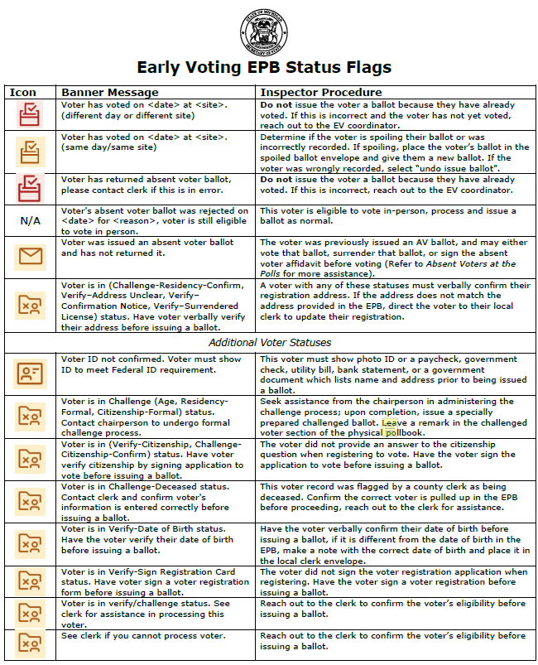
Processing Voters – EV EPB Status Flags
Resources:
Early Voting EPB Status Flags
Notes:
There is a separate guide for the Early Voting EPB that provides the new icons and banner language unique to the updated program.
Michigan Bureau of Elections
Train the Trainer 2026
26

Slide 27
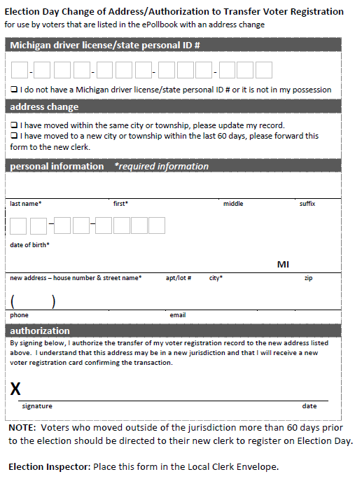
Election Day Issues: Voters Who Have Moved
Resources:
Election Inspector Training Points Booklet
Notes:
If a voter’s address does not match their record on the EPB or precinct list, and they have moved:
Voter moved from address listed on registration list
New address within the jurisdiction
New address outside the jurisdiction
Less than 60 days ago – Change of Address/ Transfer Form
60 days or more – go to new clerk and register on Election Day
Change of Address/ Transfer Form and allowed to vote
Michigan Bureau of Elections
Train the Trainer 2026
27

Slide 28
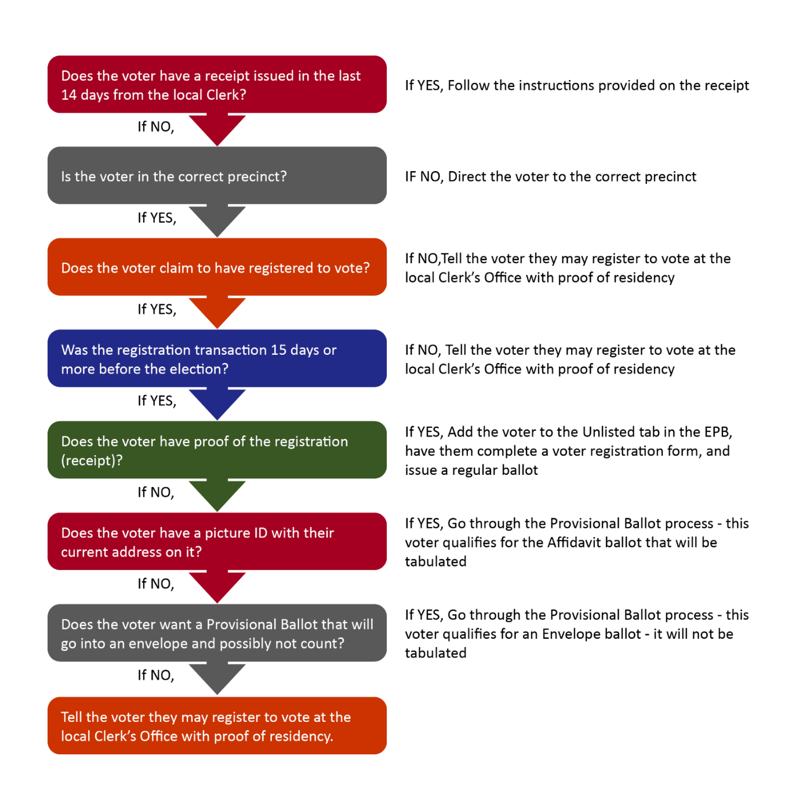
Processing Voters – “Missing” Voters
Extras:
If the voter indicates that they have not previously registered to vote or changed their address, they must be directed to the clerk's office.
If a voter claims to have already registered to vote, the Provisional ballot process is still available; utilize the Provisional Ballot form as guide.
Resources:
Election Inspectors’ Training Points Booklet
Election Inspectors’ Procedure Manual
Notes:
Voter not listed in EPB?
Check “Other” tab.
Ask if registered under different name.
Consult flowchart.
Inform voter of same-day registration option available at clerk’s office.
Michigan Bureau of Elections
Train the Trainer 2026
28

Slide 29
Provisional Ballots
Resources:
Provisional Ballot Guide – Coming Soon
Notes:
A provisional ballot is an option if all the following are true:
1. The voter’s name is not listed in the e-pollbook and
2. The voter claims to have previously registered to vote for this election (either at least 15 days before this election, or within 14 days at the clerk’s office with proof of residency) and
3. The voter is unable or refuses to go to the clerk's office to register to vote on Election Day.
If this is the case, then election inspectors should have the voter fill out the Provisional Ballot Form, then complete the provided Election Inspector Review Checklist. Depending on the answers, the voter will then be issued one of the two types of provisional ballot - affidavit or envelope.
Michigan Bureau of Elections
Train the Trainer 2026
29

Slide 30
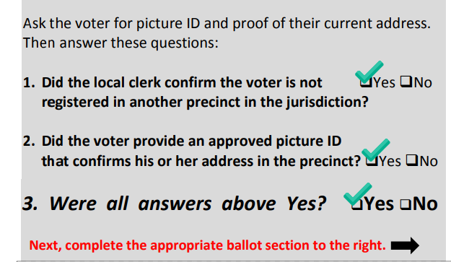
Provisional Affidavit Ballots
Resources:
Provisional Ballot Guide
Notes:
Provisional Affidavit Ballot: A provisional ballot issued if the voter has a photo ID confirming their registration address that is tabulated in the polling place after the voter signs the corresponding affidavit.
Instructions:
  Write the ballot number in pencil on the upper left-hand corner of the ballot, being sure to avoid any barcodes or timing marks (not on the ballot stub).
  Conceal this number with a small piece of white paper taped over the number.
  Enter the voter and ballot number in the e-pollbook and record it as an affidavit ballot.
  Give the voter a copy of the Notice to Voters Who Do Not Appear on the Precinct’s Registration List.
  Issue the ballot and instruct the voter to mark the ballot, then deposit it in the tabulator (this ballot is tabulated in the polling place).
  Place the Provisional Ballot Form in the Provisional Ballot Storage Envelope.
Michigan Bureau of Elections
Train the Trainer 2026
30

Slide 31
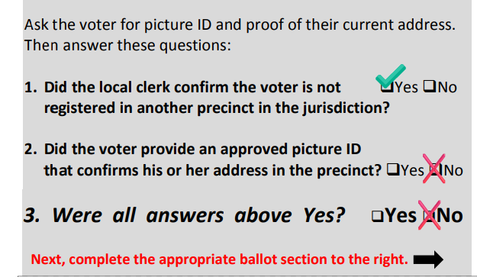
Provisional Envelope Ballots
Extras:
Provisional Envelope Ballots are reviewed within 6 days after the election in the clerk’s office, and if made eligible, tallied and added to the totals at the canvass.
Resources:
Provisional Ballot Guide
Notes:
Provisional Envelope Ballot: A provisional ballot issued if the voter does not have a photo ID confirming their registration address that is secured in an envelope for further verification and not tabulated in the polling place.
Instructions:
  Write the ballot number in pencil on the upper left-hand corner of the ballot, being sure to avoid any barcodes or timing marks (not on the ballot stub).
  Conceal this number with a small piece of white paper taped over the number.
  Enter the voter and ballot number in the e-pollbook and record it as an envelope ballot.
  When issuing the ballot, explain to the voter that the voted ballot cannot be deposited in the tabulator. Additionally, if the voter is attempting to vote in the wrong precinct and declines to travel to the correct precinct to vote, tell the voter that the provisional ballot will not count if it is confirmed that the person voted in the wrong precinct.
  Give the voter a copy of the Notice to Voters Who Do Not Appear on the Precinct’s Registration List.
  Issue the ballot and instruct the voter to mark the ballot, place it inside the Provisional Ballot Form Envelope and return it to an election inspector.
  Place the Provisional Ballot Form Envelope containing the voted ballot inside the Provisional Ballot Storage Envelope for delivery to the local clerk after polls close.
Michigan Bureau of Elections
Train the Trainer 2026
31

Slide 32
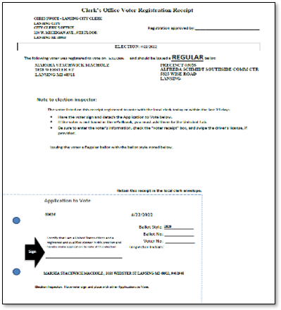
Processing Voters – Election Day Registrants
Extras:
Election Day registrants can vote absentee in the clerk's office or cast a ballot in their precinct
Precinct inspectors should be directed to follow the steps on the receipt
No more Challenged Ballots for voters who register to vote on Election Day.
Resources:
0-14 Day Quick Guide
Notes:
Election Day Voter Registration Receipt:
Election Day registrants will receive a QVF-printed receipt when processed:
Michigan Bureau of Elections
Train the Trainer 2026
32

Slide 33
Election Inspector Checks and Balances – Party Affiliation
Notes:
Election Inspector Roles | 1 of each major political party – Republican and Democratic | Any 2 opposing political parties recognized in Michigan
Boards must have at least 1 of each party | X
May seal ballot containers | X
May assist voters |  | X
May be appointed chairperson |  | X
Party must be notified of inspector appointments (in state/federal elections) | X
May duplicate ballots |  | X
May be a receiving board member | X
May deliver materials to Receiving Board | X
May serve on Early Voting Closing Board | X
Michigan Bureau of Elections
Train the Trainer 2026
33

Slide 34
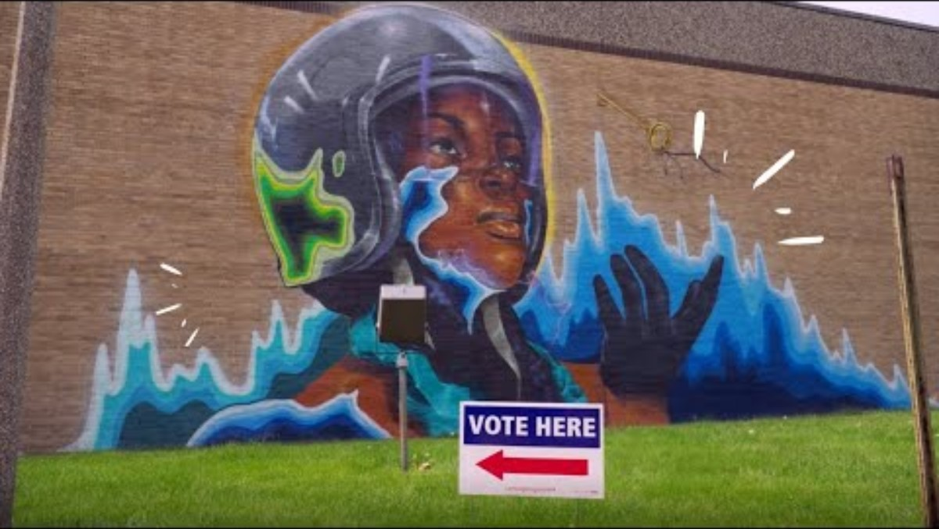
Processing Voters: Assisting Voters
Michigan Bureau of Elections
Train the Trainer 2026
34

Slide 35
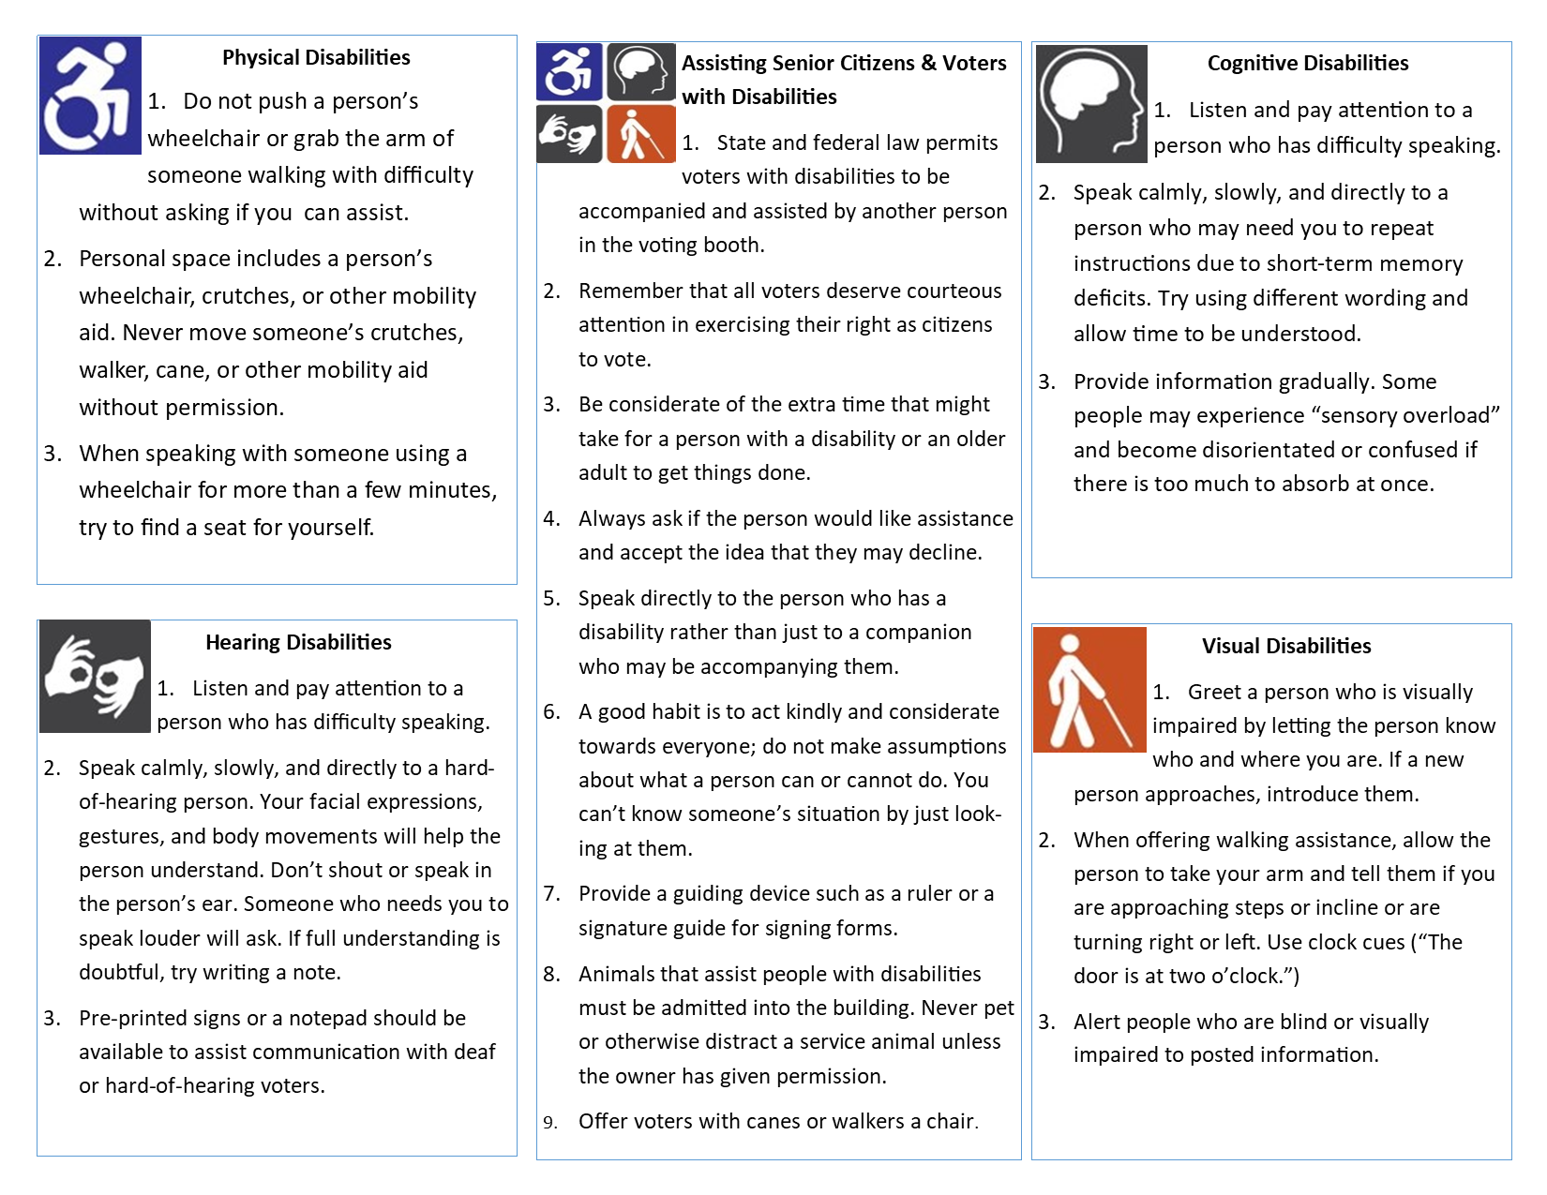
Processing Voters: Assisting Voters with Disabilities
Extras:
No assumptions should be made about the nature of a person's disability or support needs.
Resources:
Disability Etiquette Guide
Notes:
Michigan Bureau of Elections
Train the Trainer 2026
35

Slide 36
Processing Voters: Assisting Voters
Resources:
VAT Single Page Informational Handout
Notes:
Voter assist terminal (VAT):
Allows ballot secrecy and independent assistance in marking ballot.
Guide voter to VAT.
Explain VAT is a ballot marking device, not a tabulator.
When finished marking ballot, the voter takes printed ballot to tabulator.
Key reminders:
VAT is available for all voters, not just those with disabilities. Never deny or restrict access if a voter requests it.
Encouraging use may help reduce wait times.
VAT prevents crossover voting in partisan primaries, stray marks, and overvotes or unintended undervotes.
VAT does not retain voter’s selections after the session is complete, just prints out a marked paper ballot that is tabulated with all other ballots in the polling place.
Michigan Bureau of Elections
Train the Trainer 2026
36

Slide 37
Processing Voters: Assisting Voters
Extras:
Refer to flipchart for scripts in offering assistance
Record Assisted Voter in EPB Remarks unless voter utilizing VAT.
A person does not need to state or present evidence of their disability to receive an accommodation.
Notes:
Precinct worker assistance:
If voter prefers personal assistance, two inspectors with different political affiliation shall assist.
Curbside:
Curbside voting should be made available to voters unable to enter the polling location.
Utilize two inspectors who express a preference for different political parties.
The inspectors must take the ballot and secrecy sleeve to the voter and return to the polling place to cast the voter’s ballot on their behalf.
The voter must comply with all regular processing procedures.
Michigan Bureau of Elections
Train the Trainer 2026
37

Slide 38
Processing Voters: Assisting Voters
Extras:
Language and physical assistance are examples of when a voter may wish to bring a person of their choosing to assist them.
A person does not need to state or present evidence of their disability to receive an accommodation.
Resources:
Election Inspectors’ Procedure Manual
Notes:
Any individual brought by voter to assist:
A voter may be assisted by a person of the voter’s choice, as long as the person rendering assistance does not represent the voter’s employer or labor union. If a voter wishes to receive voting assistance from another person:
Are you requesting assistance to vote by reason of blindness, disability or inability to read or write? = YES
Are you the voter’s employer or agent of that employer or an officer or agent of a union to which the voter belongs? = NO
Assistant allowed
Michigan Bureau of Elections
Train the Trainer 2026
38

Slide 39
Maintaining Order
Extras:
Challengers are not authorized to approach voters or talk to them for any reason. All challenges must be directed to precinct inspectors.
Challengers who serve in an AV counting board must take and sign the oath.
Resources:
Appointments, Rights, and Duties of Election Challengers and Poll Watchers,
Election Inspectors' Procedure Manual, Election Challengers Video
Notes:
Poll watchers
Any person interested in observing voting process
Challengers
Appointed by political parties or credentialing organizations; must carry credentials
Prohibited within 100 ft. of any polling place entrance on Election Day
Restricted to public area
May not approach voters
May not be a candidate
May look at the pollbook at the chairperson’s discretion
Two allowed per party; only one challenger per party has authority to challenge – must declare an authority change
May challenge a voter’s qualifications to vote
May challenge election procedures
May be expelled for being disorderly
May be behind the voter processing tables
Must be registered to vote in Michigan
May view pollbook and election equipment
Encouraging voters to vote for or against a candidate or issue
Distributing campaign materials
Soliciting petition signatures
Requesting donations, selling tickets, etc.
Wearing of campaign materials by voters
Not required to be a registered voter
Campaigners
Michigan Bureau of Elections
Train the Trainer 2026
39

Slide 40
Processing Voters – Making Challenges
Resources:
Appointments, Rights, and Duties of Election Challengers and Poll Watchers,
Election Inspectors' Procedure Manual, Election Challengers Video
Notes:
Challengers may challenge voter eligibility or election processes.
Voter eligibility challenges
In a polling place or early voting site, may challenge voter eligibility for one of four reasons:
Person is not registered to vote
Person is less than 18 years old on Election Day
Person is not a U.S. citizen
Person has not established residency (30 days in their city/township)
May also challenge absent voters in the polls if the voter was sent an AV ballot and does not have that ballot to surrender or tabulate during early voting/Election Day
Voter-specific challenges cannot be made at an AVCB
Election process challenges
Challenge to voting process, or way that election inspectors operate a polling place, early voting site, or AVCB
Must state specific element(s) being improperly performed and the basis for that belief
Michigan Bureau of Elections
Train the Trainer 2026
40

Slide 41
Processing Voters – Resolving Challenges
Resources:
Appointments, Rights, and Duties of Election Challengers and Poll Watchers,
Election Inspectors' Procedure Manual, Election Challengers Video
Notes:
If a challenger makes a voter eligibility challenge for one of the four permitted reasons:
Chairperson or other election inspector places the voter under oath:
“I swear (or affirm) that I will truly answer all questions put to me concerning my qualifications as a voter.”
The election inspector should then ask the voter to confirm that they meet the criteria to be an eligible voter.
If, after questioning under oath, the voter confirms they are eligible to vote, the voter is permitted to vote a challenged ballot. A challenged ballot is prepared by writing the voter’s ballot number on the ballot and then covering the number with tape or a slip of paper. The voter then completes the ballot and casts in the same manner as an unchallenged voter.
If the voter does not confirm they are eligible to vote after questioning under oath, the voter is not allowed to cast a ballot.
Michigan Bureau of Elections
Train the Trainer 2026
41

Slide 42
Processing Voters – Impermissible Challenges
Resources:
Appointments, Rights, and Duties of Election Challengers and Poll Watchers,
Election Inspectors' Procedure Manual, Election Challengers Video
Notes:
Race or ethnic background
Sexual orientation or gender identity;
Physical or mental disability;
Inability to read, write, or speak English;
Need for assistance in the voting process;
Manner of dress;
Support for or opposition to a candidate, political party, or ballot question;
The appearance or the challenger’s impression of any of the above traits;
Any other characteristic not relevant to a person’s qualification
Lack of a photo ID
Impermissible reasons for challenging a voter’s eligibility include, but are not limited to:
Michigan Bureau of Elections
Train the Trainer 2026
42

Slide 43
Maintaining Order – Observers
Extras:
Resources:
Bridging Divides Institute – De-Escalation Guidance for Poll Workers
Notes:
De-escalation guidance for poll workers
Remember the goal is not to win an argument, but to calm verbal disruptions and prevent physical disruptions.
DON’T | DO
Order, threaten, or attempt to argue disinformation. Be defensive | Request and suggest before commanding or demanding. Be clear, simple, and specific with requests. Emphasize that policy is not personal: “state law does not allow” over “you are not allowed”.
Michigan Bureau of Elections
Train the Trainer 2026
43

Slide 44
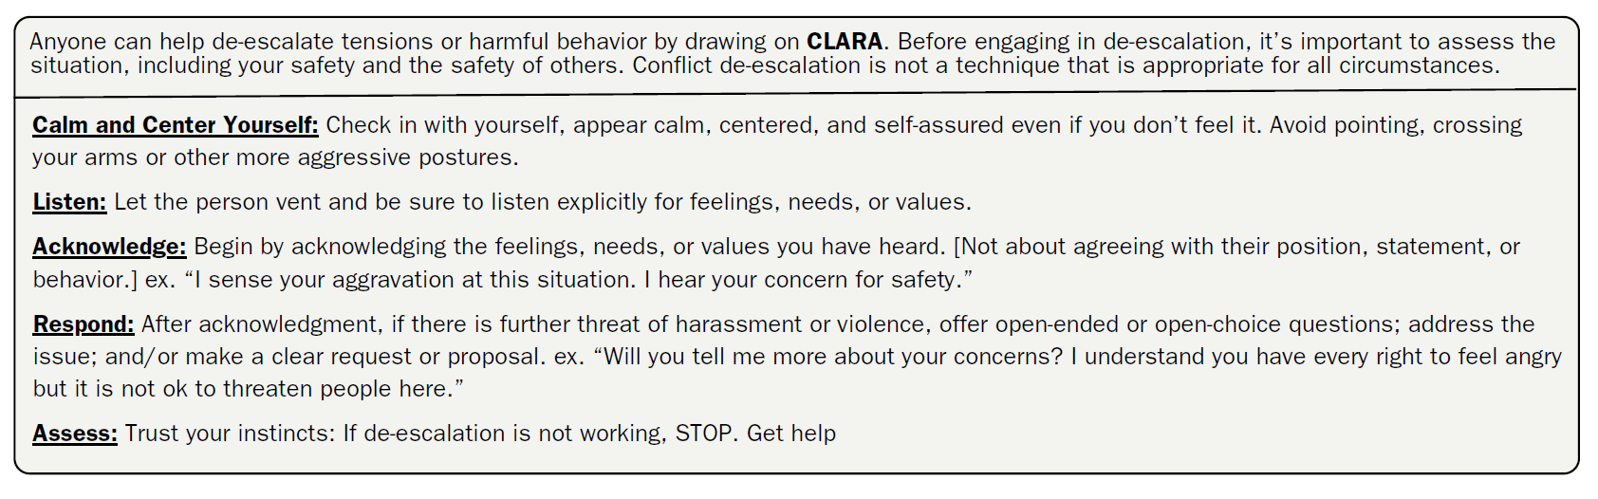
Maintaining Order – Observers
Resources:
Bridging Divides Institute – De-Escalation Guidance for Poll Workers
Notes:
Using the CLARA method
From Princeton Bridging Divide Institute De-escalation guide
Michigan Bureau of Elections
Train the Trainer 2026
44

Slide 45
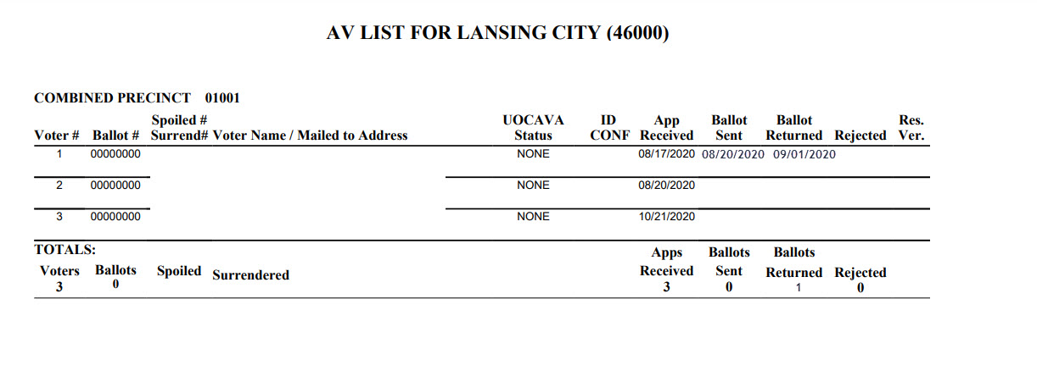
Processing AV Ballots in the Precinct
Resources:
Election Officials' Manual Chapter 8
Processing AV Ballots in the Precinct – Manual
AV Process Training Tidbits
Training Points Booklet 2026
Notes:
Election inspector duties:
  When clerk delivers ballots to precinct, inspector must balance number of ballots received with the number of eligible ballots on the AV list before processing.
  To track AV ballots processed in the precinct, use AV List of Voters report from QVF.
  Use no less than two election inspectors of differing political parties to open AV Return Envelopes, verify ballot number on stub with AV List.
  Duplication of AV ballots processed in the precinct cannot occur until after 8 p.m. Ballots requiring duplication should be held in the auxiliary bin of the tabulator until that time.
Michigan Bureau of Elections
Train the Trainer 2026
45

Slide 46
Absent Voter Counting Boards
Extras:
Sequestration is no longer required
In order to process before Election Day, clerk of jurisdiction must notify department of state by legal deadline.
Resources:
Election Officials' Manual Chapter 8
AVCB Manual
AV Process Training Tidbits
Training Points Booklet 2026
Notes:
Absent voter counting boards:
  AV counting board-specific pollbook required with oaths, ballot summary, remarks, etc.
  Poll watchers/challengers must sign oath to enter
  Early AV processing: AVCBs can be convened to process and tabulate AV ballots before Election Day
    Jurisdictions of fewer than 5,000 residents can establish AVCBs to process and tabulate ballots on the Monday before Election Day
    Jurisdictions of 5,000 or more residents can establish AVCBs to process and tabulate AV ballots any of the 8 days before Election Day (up to the second Monday before)
  Specialized inspector teams/training:
    Duplication
    Adjudication
    Help desk/troubleshooting
  Important remarks while processing:
    Wrong election ballot
    Two ballots in one envelope
    Empty envelope/missing ballot
Michigan Bureau of Elections
Train the Trainer 2026
46

Slide 47
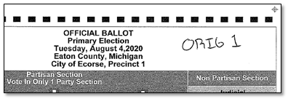
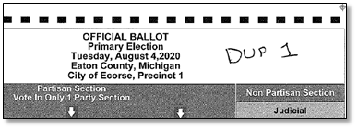
Ballot Duplication
Extras:
Ballot duplication mostly occurs when processing AV ballots, but may be needed on Election Day for ballots in the auxiliary bin.
Can occur during the day in AVCB.
Resources:
Processing AV Ballots in the Precinct - Manual
AVCB Manual
Training Points Booklet 2026
Notes:
Ballots unable to be read by the tabulator at first (including FWABs and electronic MOVE ballots) should be duplicated after the polls close by two inspectors of different political parties.
Process:
Write “Dup 1” on an unused ballot (not the stub).
Write “Orig 1” on the voted ballot.
Following validity standards, use the reader/checker method to copy the valid votes onto Dup 1.
  Marks must be in target area and consistent to count.
Place duplicated ballot in tabulator.
Place original ballot in Original Ballot Envelope.
Repeat as necessary, using the next sequential number (Orig./Dup. 2, 3, etc.).
Michigan Bureau of Elections
Train the Trainer 2026
47

Slide 48
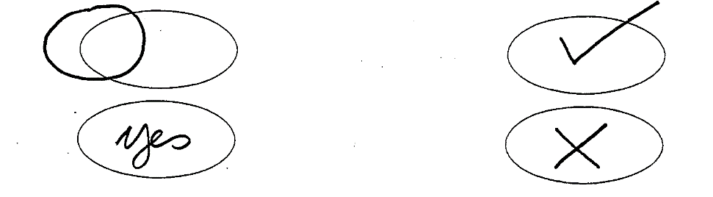
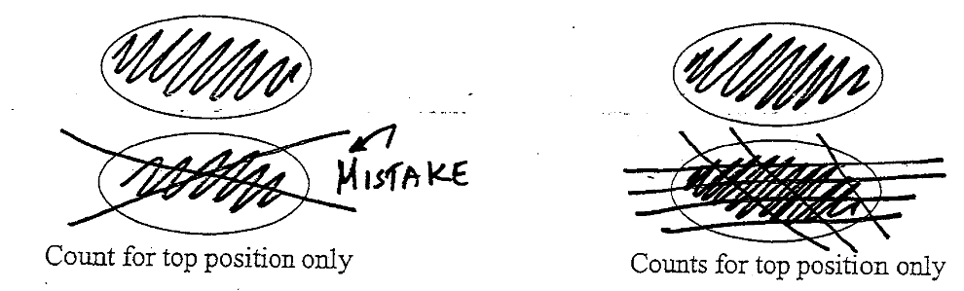
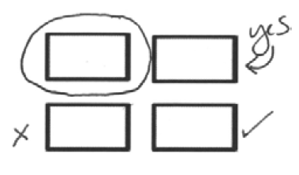

Processing False Reads on Ballots for Duplication
Extras:
Ballot duplication mostly occurs when processing AV ballots, but may be needed on Election Day for ballots in the auxiliary bin.
Can occur during the day in AVCB.
Resources:
Processing AV Ballots in the Precinct - Manual
AVCB Manual
Ballot Duplication
Exercise
Notes:
Valid Markings
Invalid Markings
Corrections
Stray Marks
Two step validity standard:
1. Mark in vote target area 2. Mark consistent with all other marks
Michigan Bureau of Elections
Train the Trainer 2026
48

Slide 49
Closing the Polls – Election Day
Extras:
Doors to the precinct remain unlocked through the process
Challengers may remain in the processing area for closing procedures.
Candidates and members of the public may observe the closing procedures from the public area.
Resources:
EPB Election Inspector Manual,
Election Inspectors' Procedure Manual,
Closing the Polls Video
Notes:
Closing the polls procedure overview:
Announce the close of polls at 8 p.m.; all eligible voters in line at the close of polls can still vote.
Check auxiliary bin for any ballots requiring duplication and duplicate ballots using two election inspectors of differing political parties.
Tabulate all remaining ballots; close the polls on the tabulator to print totals tapes.
Complete Ballot Summary and perform final e-pollbook backup.
Save and print all e-pollbook reports.
Complete Election Inspectors’ Completion Certificate & Statement of Votes.
Secure final Statement of Votes records in appropriate envelopes.
Seal approved ballot and transfer containers.
Michigan Bureau of Elections
Train the Trainer 2026
49

Slide 50
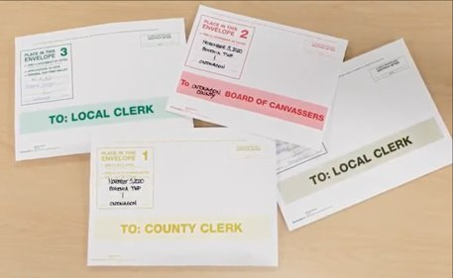
Closing the Polls – Envelopes
Extras:
Statement of Votes pieces: Election Inspector Completion Certificate w/signatures, Seal Verification, Write-in Statement of Votes, Totals Tape
Envelopes may be organized at Receiving Board, must be sealed with paper seal
Resources:
Election Inspectors' Procedure Manual
Closing the Polls – Envelopes Video
Notes:
TO COUNTY CLERK:
  Pollbook with statement of votes and totals tape
TO COUNTY BOARD OF CANVASSERS:
  Statement of Votes (copy) with totals tape attached
TO LOCAL CLERK:
  Statement of Votes (copy) with zero tape and totals tape attached
  Applications to Vote
  Blank test VAT ballot
  Any surrendered AV ballots
LOCAL CLERK ABSENTEE:
  AV applications
  AV envelopes
  AV list of voters
PROV BALLOT STORAGE (if applicable)
Michigan Bureau of Elections
Train the Trainer 2026
50

Slide 51
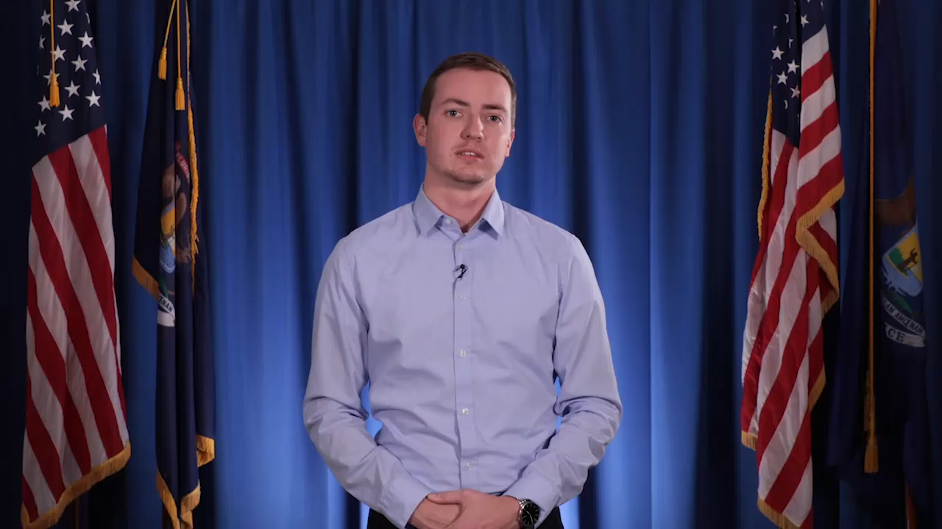
Closing the Polls – Envelopes
Don’t Forget:
Resources:
Notes:
Michigan Bureau of Elections
Train the Trainer 2026
51

Slide 52
Closing the Polls – Containers
Extras:
Provisional Ballot Envelope is sent to the local clerk.
E-pollbook flash drive in envelope w/red paper seal to Local Clerk or transfer container as directed
Ballot container and transfer container seals must be recorded in the pollbook
Resources:
Election Inspectors' Procedure Manual
Notes:
Secure approved ballot containers:
The ballot container should be sealed with specific items inside:
  All voted ballots (including VAT)
  All unused ballots
  SPOILED BALLOT envelope
  ORIGINAL ballot envelope
  Note: If in an AVCB, ballots should be separated and bundled by precinct with documentation of which precincts are secured in each container
Secure approved transfer containers:
The transfer container should be sealed with specific items inside:
  Tabulator memory device/s
  VAT memory device
  e-pollbook flash drive (if directed)
Michigan Bureau of Elections
Train the Trainer 2026
52

Slide 53
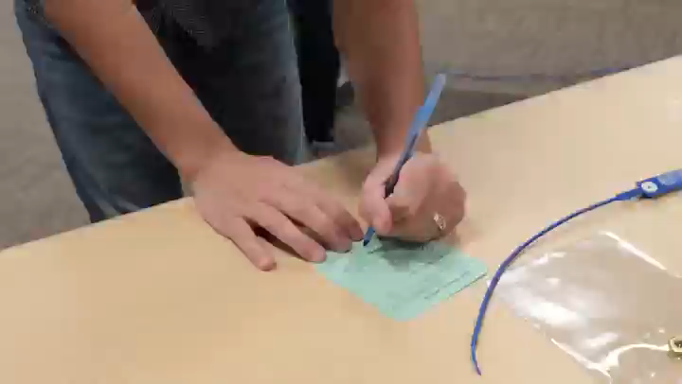
Closing the Polls – Containers
Don’t Forget:
Resources:
Notes:
Michigan Bureau of Elections
Train the Trainer 2026
53

Slide 54
Closing the Polls – Early Voting
Extras:
Doors to the early voting site remain unlocked through the process
Challengers may remain in the processing area for closing procedures.
Candidates and members of the public may observe the closing procedures from the public area.
Resources:
Early Voting Training Points Booklet – Coming Soon
Notes:
Closing the polls procedure overview:
Announce the close of polls at close of early voting hours for the day; all eligible voters in line at the close of polls can still vote.
Check auxiliary bin for any ballots requiring duplication and duplicate ballots using two election inspectors of differing political parties.
Tabulate all remaining ballots; execute End of Day Tabulator Status/Interrupt Reports on the tabulator.
Complete Daily Reconciliation Summary.
Print EV e-pollbook reports.
Complete seal verification/chain of custody documentation; signed by all election inspectors present at close.
Seal approved ballot containers.
Michigan Bureau of Elections
Train the Trainer 2026
54

Slide 55
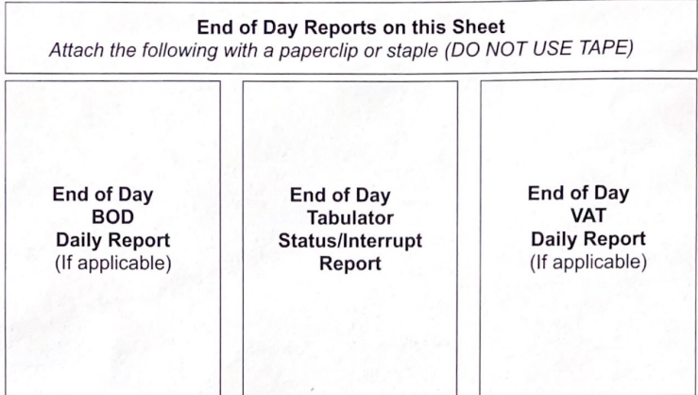
Closing the Polls – Early Voting
Extras:
Emphasis on balancing at close of Early Voting Day is Number of Ballots Cast vs. Number Voters, using the EPB voter list and tabulator counter.
Now required to print BOD and VAT reports
Resources:
Notes:
Ballot Reconciliation Summary
Michigan Bureau of Elections
Train the Trainer 2026
55

Slide 56
Closing the Polls – Early Voting
Extras:
Provisional Ballot Envelope is sent to the local clerk.
Ballot seals must be recorded in the pollbook each night.
Resources:
Notes:
Securing ballots and physical pollbooks and supplies:
At the conclusion of each day of early voting, the approved ballot container should be sealed with specific items inside:
  All voted ballots (including VAT)
  SPOILED BALLOT envelope
  ORIGINAL ballot envelope.
Note: Any unvoted ballot stock along with physical pollbook may be placed in a box under red paper seal and secured in the locked early voting site/supply closet.
Option 1: Separate approved ballot container for each day of early voting. Seal number recorded in pollbook.
Option 2: Single approved ballot container used throughout early voting. Seal number recorded in pollbook each night, verify previous day’s seal, seal is dropped into container, new seal affixed and recorded in pollbook, voted ballots should be sorted by day.
Michigan Bureau of Elections
Train the Trainer 2026
56

Slide 57
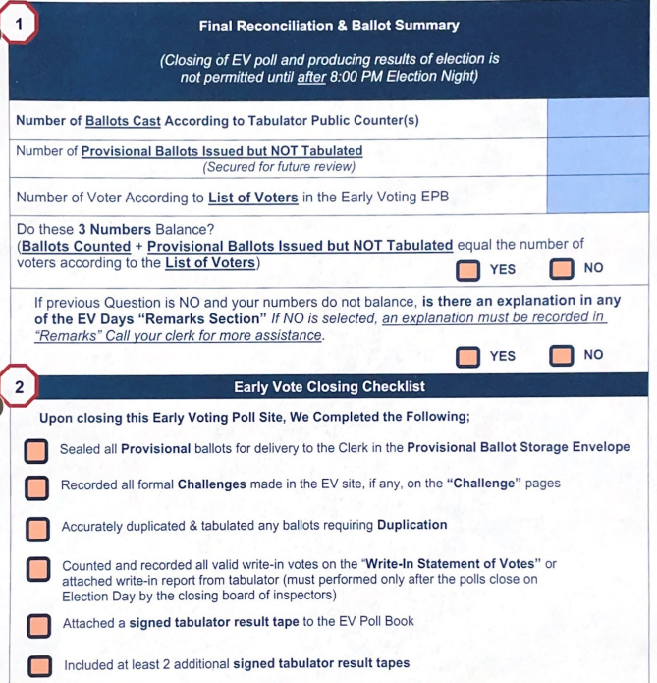
Closing the Polls – Early Voting (Final Close)
Extras:
Write-in vote accumulation done on Election Night in one of the following ways:
If totals tapes have write-in images, tapes are attached to write-in statement of votes.
If totals tapes have no write-in images, votes are tallied by closing inspectors after reviewing ballots containing write-in votes.
Notes:
Final EV site closing​
Completed by EV closing inspectors after 8 p.m. Election Night:​
Print three Totals Tapes from each EV tabulator​.
Accumulate Write-ins​.
Complete Final Reconciliation & Ballot Summary​.
Assemble Statement of Votes Envelopes for county clerk, board of county canvassers, local clerk (EV Coordinator/host): one Totals Tape, Write-in Statement of Votes, Copy of Final Reconciliation & Ballot Summary​
Michigan Bureau of Elections
Train the Trainer 2026
57

Slide 58
Receiving Boards
Extras:
Purpose is to double check precinct records and ensure recountability
If using election day election inspectors as receiving board members, additional receiving board specific guidance should be provided.
Receiving Board checklists must be placed in the pollbook.
Receiving Board receipt documenting delivery of ballot container must be signed by inspectors
Resources:
Receiving Board Checklist & Guide
Training Points Booklet 2026
All election night materials must go to a receiving board for review after closing
Priorities
Verify the pollbook and statement of votes are not sealed in the ballot container
Confirm ballot container was properly sealed
Confirm seal number was properly recorded
Number of voters in pollbook equals number of ballots tabulated
Correcting mistakes
Election inspectors should correct at the direction of the receiving board
Remark in the pollbook
Signed by election inspectors and receiving board members
Eligibility
Two election inspectors of opposing major political parties
Appointed by election commission
Michigan Bureau of Elections
Train the Trainer 2026
58

Slide 59
Electronic Pollbook
Key reminders and upcoming updates
Michigan Bureau of Elections
Train the Trainer 2026

Slide 60
EPB Modernization Roadmap (as of Feb. 2026)
Notes:
Phase 1:
Early Voting EPB Accessibility (WCAG 2.0) Update
Beginning in May 2026
Phase 2:
Complete Early Voting EPB Update
Expected for 2027
Future Phases:
Connected Election Day EPB, AV Counting Board EPB
Other Updates
Election Day EPB Accessibility Update: Downloadable offline program resembling updated EV EPB
Michigan Bureau of Elections
Train the Trainer 2026
60

Slide 61
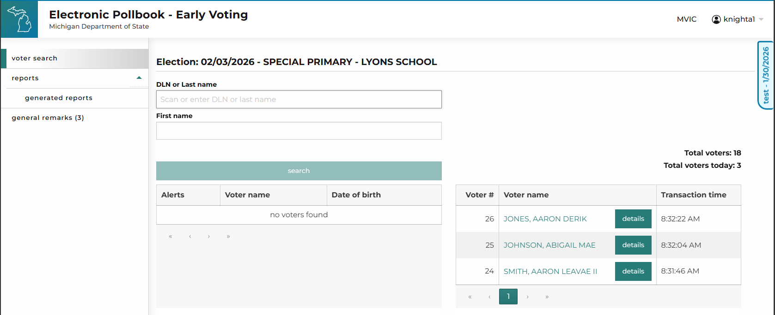
Early Voting EPB Updates
Resources:
Early Voting EPB Clerk and Inspector Manuals
Early Voting EPB Modernization Project
Change Summary
Notes:
2026 new feature highlight
Updated, accessible interface
New report generation process
Michigan Bureau of Elections
Train the Trainer 2026
61

Slide 62
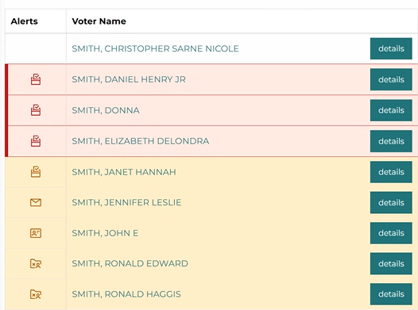
Early Voting EPB Updates
Extras:
Updated Early Voting EPB Training Materials are available in the eLearning Center
Live Early Voting EPB Training Sandbox environment available
Resources:
Early Voting EPB Clerk and Inspector Manuals
Early Voting EPB May 2026: Change Summary
Notes:
2026 new feature highlight
Voter status icons and colors appear in voter search (icons can be hovered over to give preview of status message)
Voter status flags now appear as banners in the voter’s record for increased visibility.
AV ballot statuses addressed within “Issue Ballot” flow. All other statuses coming in 2027 update.
Michigan Bureau of Elections
Train the Trainer 2026
62

Slide 63
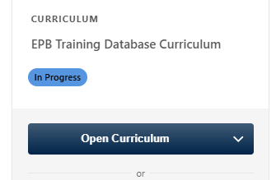
Election Day EPB Training Materials
Resources:
Election Day EPB eLearning Playlist
Election Day EPB Training Scenarios
Notes:
EPB procedural training videos
Logging in
Searching for voters
Issuing/spoiling ballots
Saving final reports
Election Day EPB Training Database
Includes
  Sample EPB
  Index of voters and statuses
  Precinct List
  AV List
Resources are available from BOE for training EPB inspectors. It is strongly recommended to have hands-on training with EPB laptops before Election Day.
Michigan Bureau of Elections
Train the Trainer 2026
63

Slide 64
Developing a Training Program
Format, best practices, and resources
Michigan Bureau of Elections
Train the Trainer 2026

Slide 65
Election Inspector Training Formats
Resources:
Long form Election Inspector Training Power Point in eLearning.
Training Points Booklet
Notes:
Should your training be…
In-person, hands-on training with stations?
Preferred option
In-person, lecture format?
Virtual, lecture format?
Test
Only for experienced and previously certified inspectors
Should include mention of all recent updates to elections
Not recommended
Michigan Bureau of Elections
Train the Trainer 2026
65

Slide 66
Election Inspector Training Formats
Notes:
Inspector roles/training audiences
General inspector training
Early voting
AV ballot processing
Receiving board
Chairperson
Michigan Bureau of Elections
Train the Trainer 2026
66

Slide 67
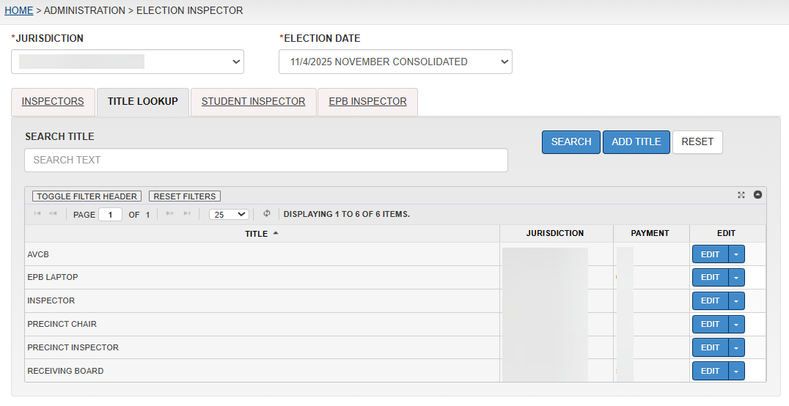
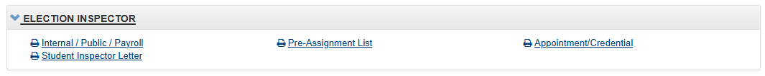
Election Inspector QVF Tools
Extras:
Reports available for printing inspector letters or listings for payroll.
Resources:
QVF Manual Ch. 12
Notes:
Use QVF to track what training your inspectors have received.
Michigan Bureau of Elections
Train the Trainer 2026
67

Slide 68
Other Election Inspector Training Topics
Notes:
Election Procedures
Electronic Poll Books
Election Security – Emergency Scenarios
Guns in Polling Places
Election “Observers”
Assisting Voters, ADA, Accessibility
Michigan Bureau of Elections
Train the Trainer 2026
68

Slide 69
Election Inspector Training Resources
Notes:
The Bureau has organized resources to be utilized in election inspector training:
eLearning Playlist for Inspector Training
  This presentation
  Election Inspector Training PowerPoint
  EPB Video Download Packet
  Absent Voters at the Polls
  Training Points Booklet
  Election Inspector Procedural Manual (Flipchart)
  Opening/Closing Videos
    Ballot Container Video
    Envelopes Video
  Processing AVs in an AVCB Video
Michigan Bureau of Elections
Train the Trainer 2026
69

Slide 70
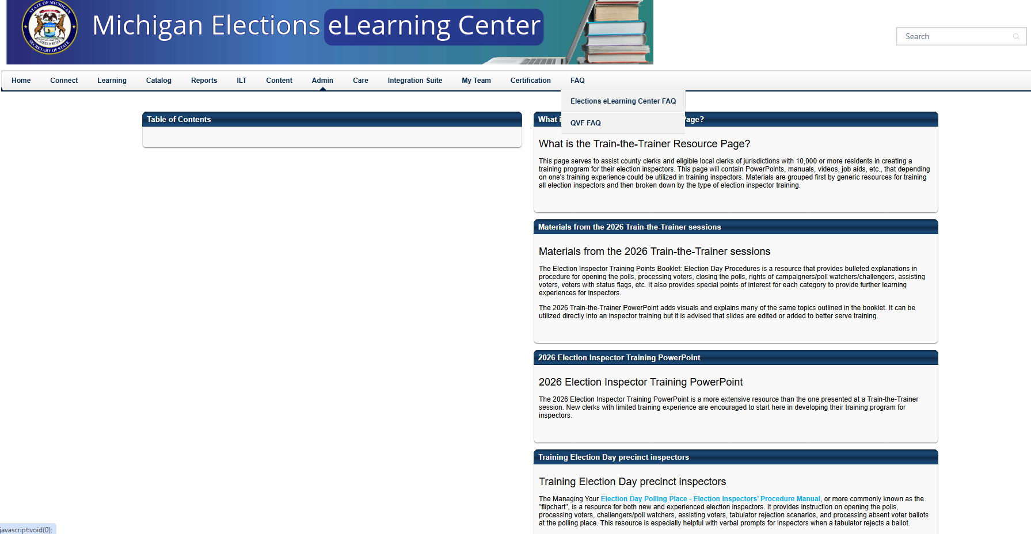
Election Inspector Training Resources
Notes:
A new Train-the-Trainer resource page will be available soon under the FAQ tab in eLearning.
It will have all related materials that we covered in training along with other useful materials for election inspector training, linked to where they exist in eLearning.
Michigan Bureau of Elections
Train the Trainer 2026
70

Slide 71

Questions?
Notes:
Upcoming training:
May Election Training Tidbits – April 2026
EV EPB Virtual Training –
April 2026
Election Cycle Update (83-County Tour) – May/June 2026
Michigan Bureau of Elections
Train the Trainer 2026
71

